Slide 1
Examples of Working with Neighborhood Geospatial Database
Aijing Gao
Supervisor: Dr. Ben Goldstein
Jan.25, 2018

Slide 2
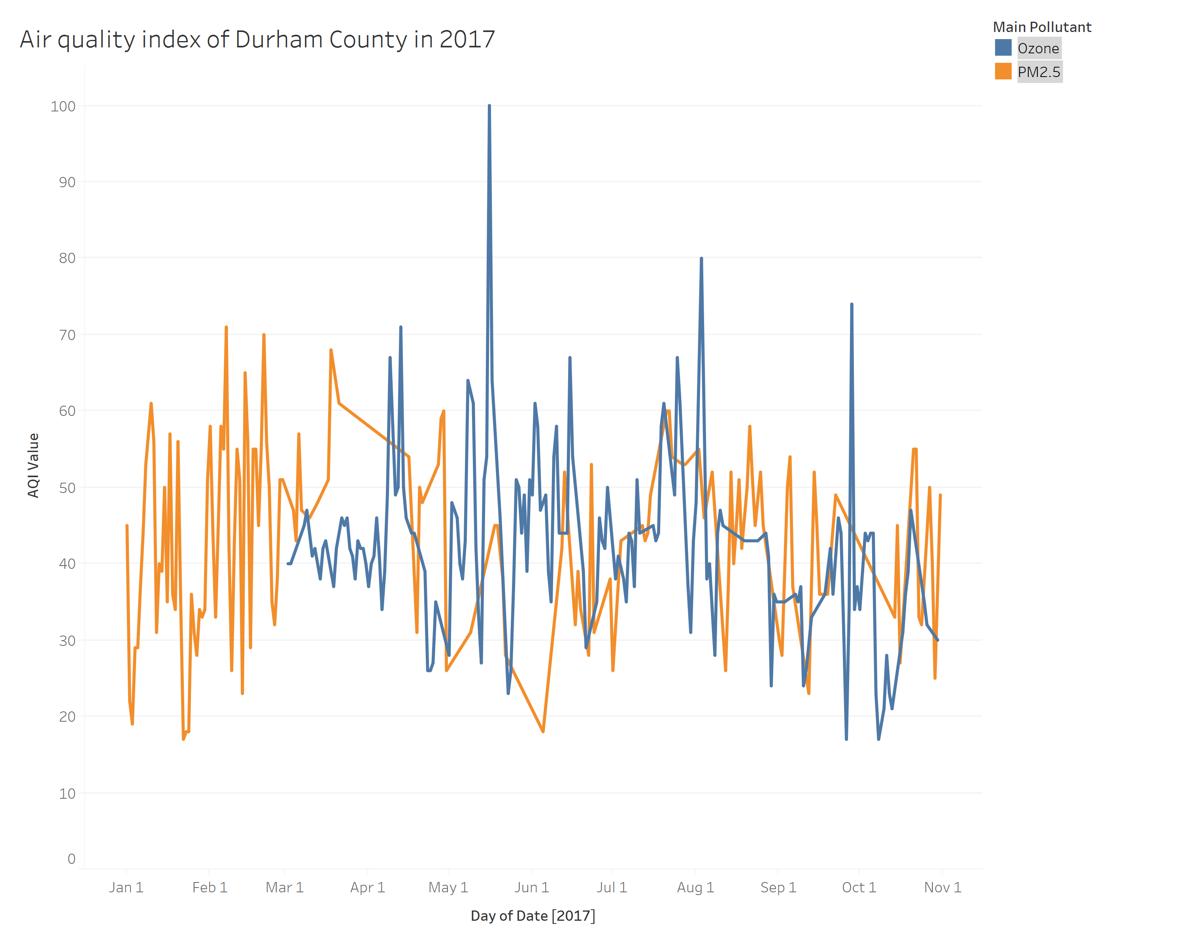

Slide 3
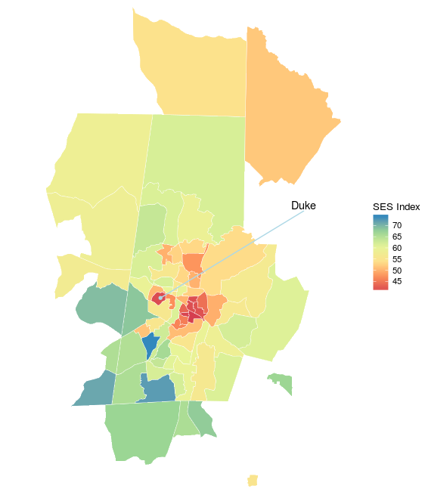
SES index over Census Tract of Durham County

Slide 4
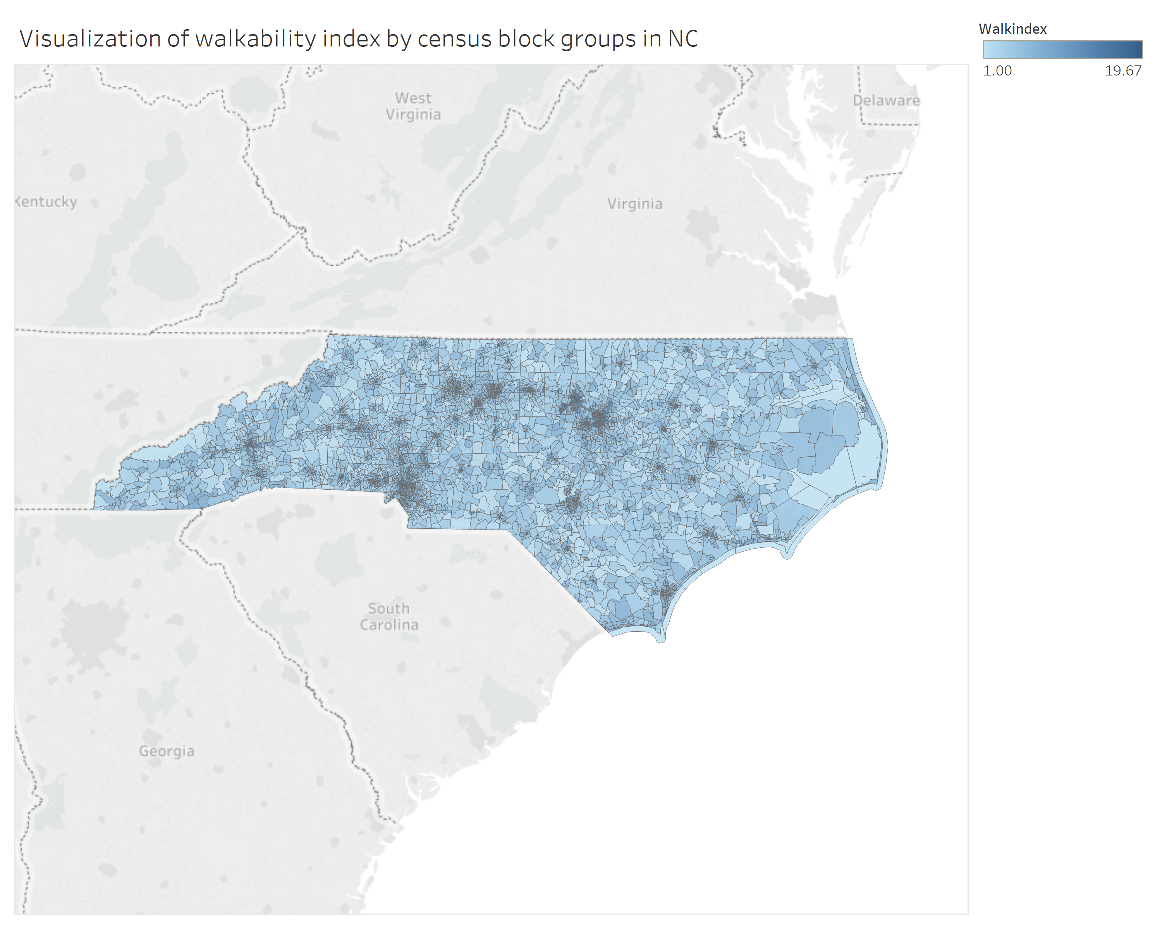
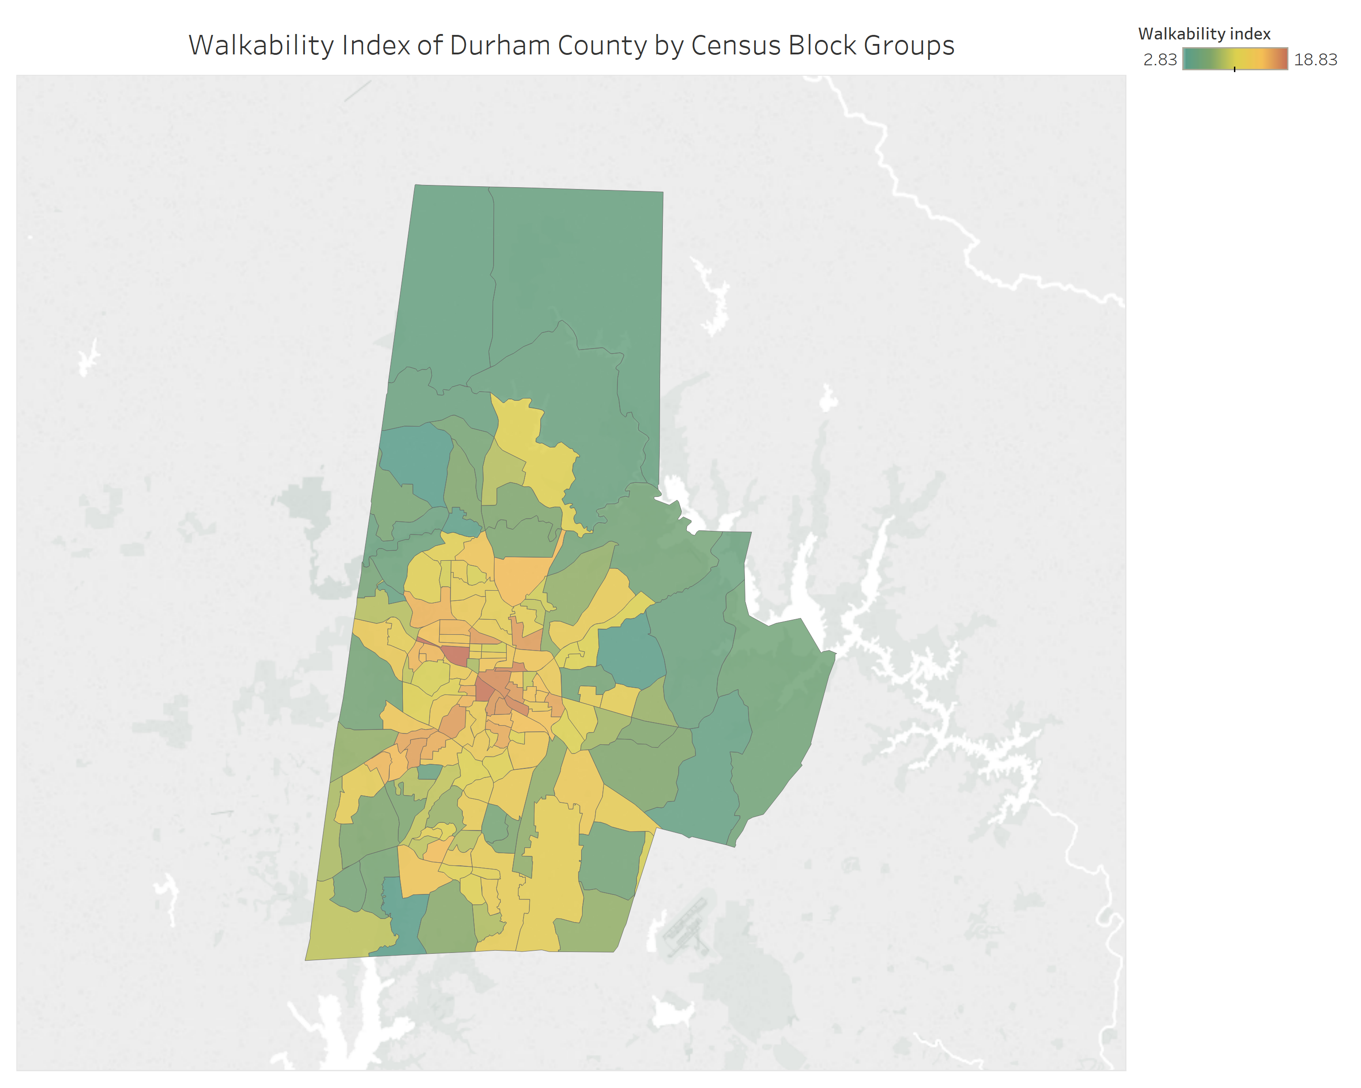

Slide 5
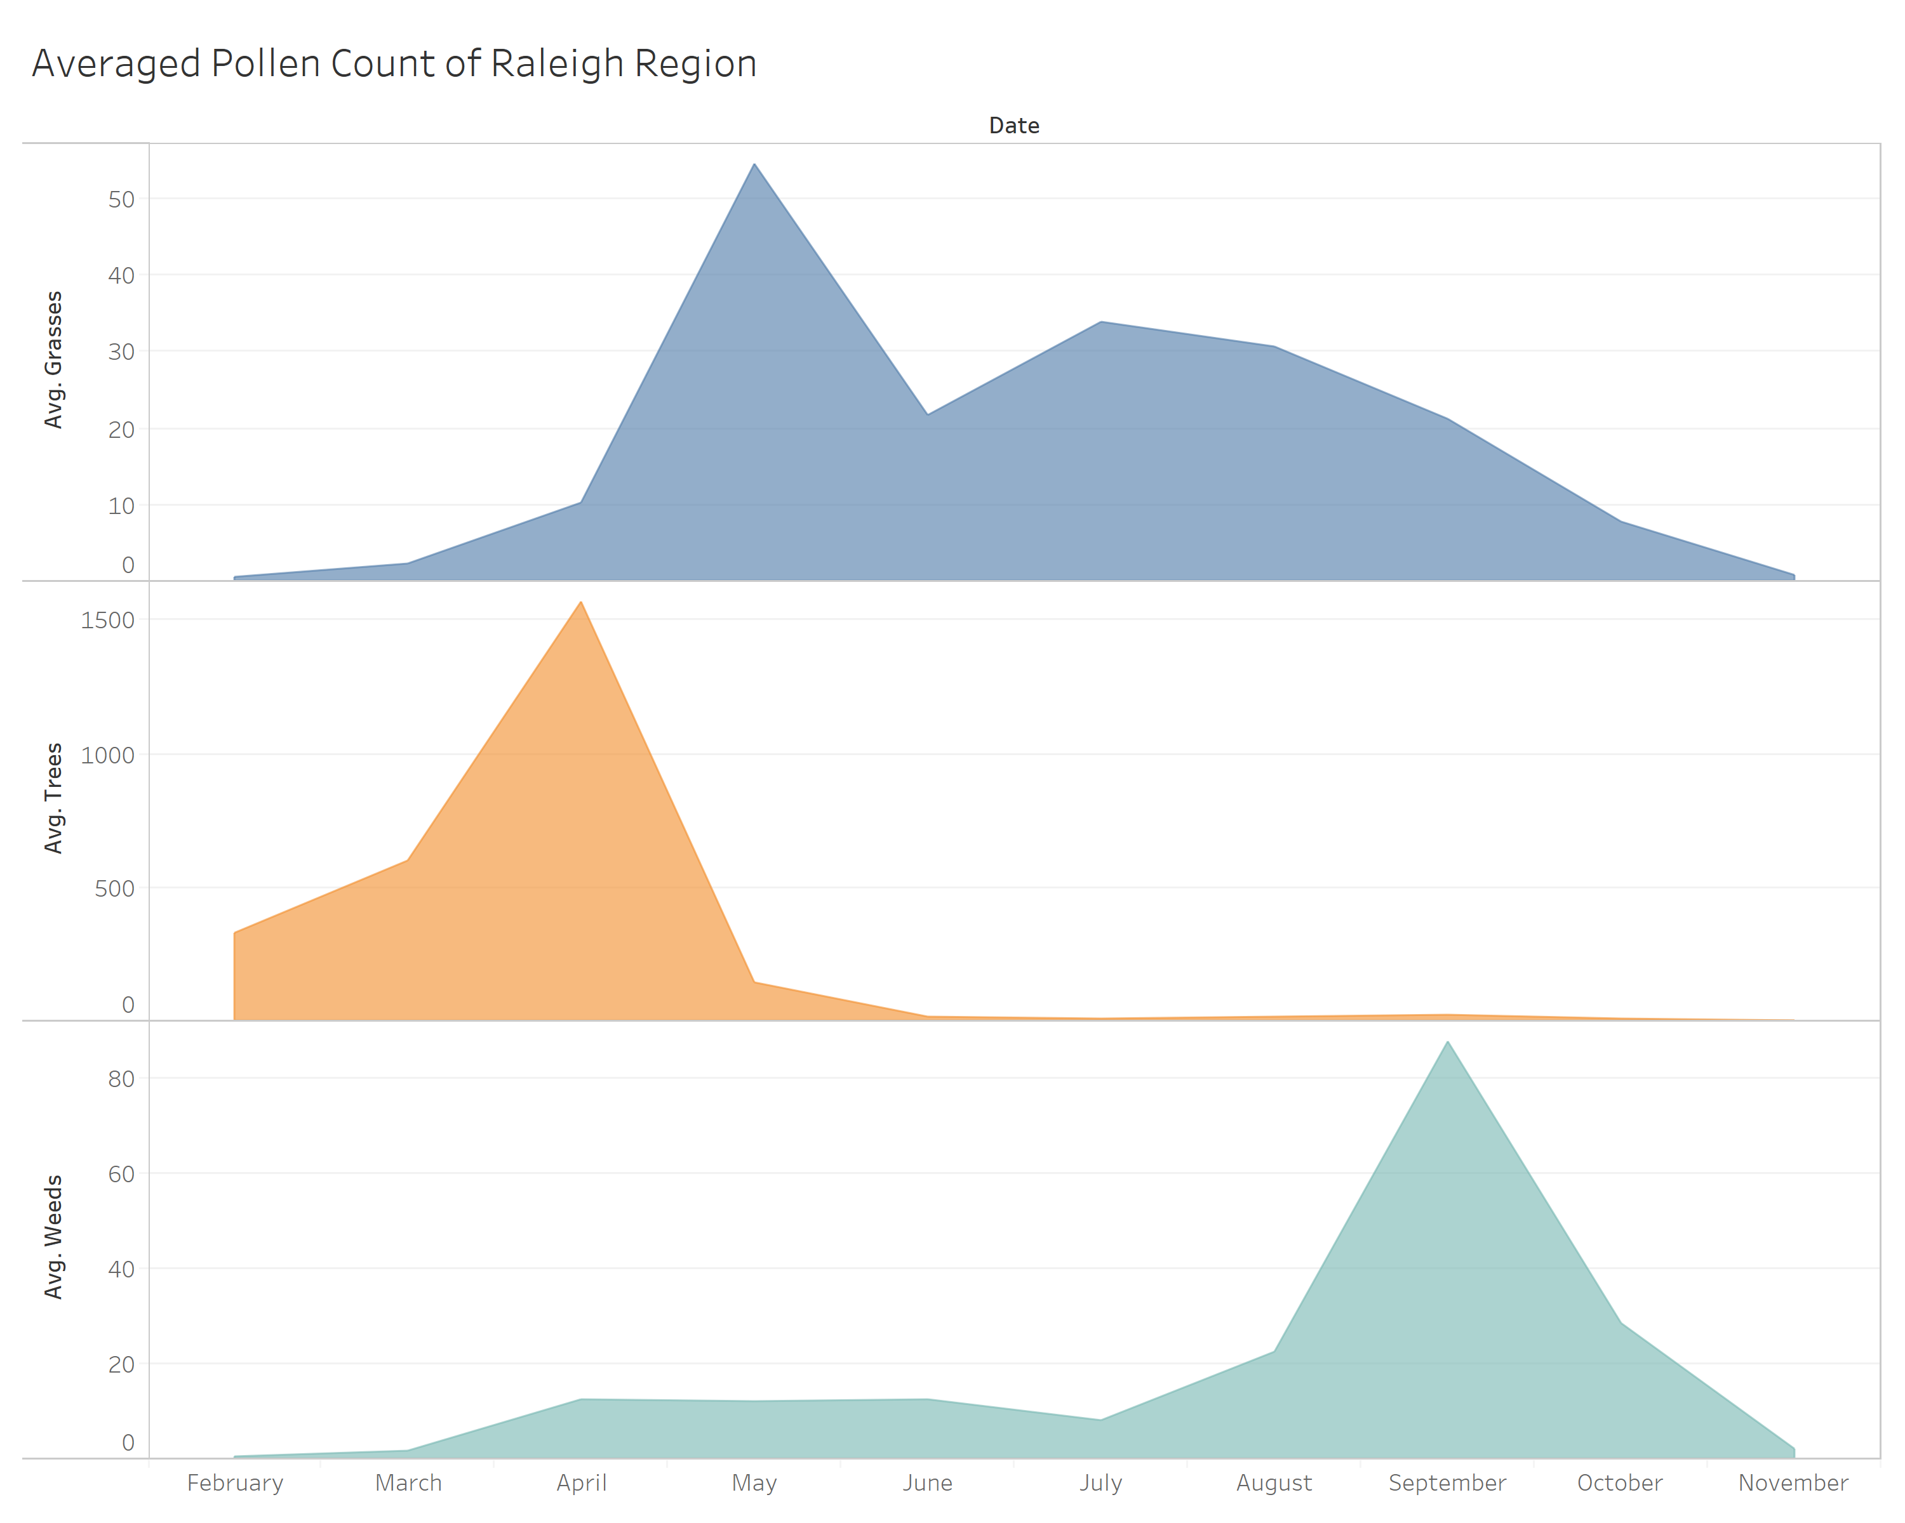

Slide 6
